Slide 1
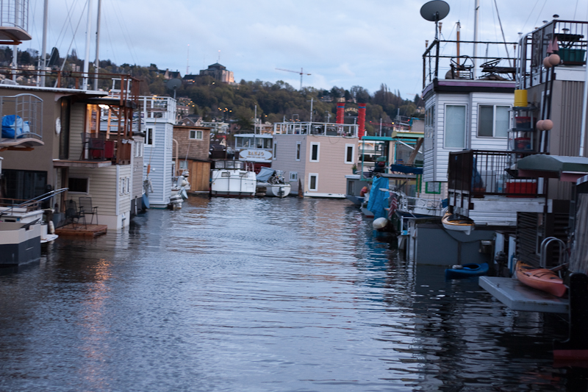
Class 11:
Mining Pools and Attacks
Cryptocurrency Café
UVa cs4501 Spring 2015
David Evans

Slide 2
Plan for Today
PointCoin Update
Mining Pools
Attacks and Vulnerabilities

Slide 3
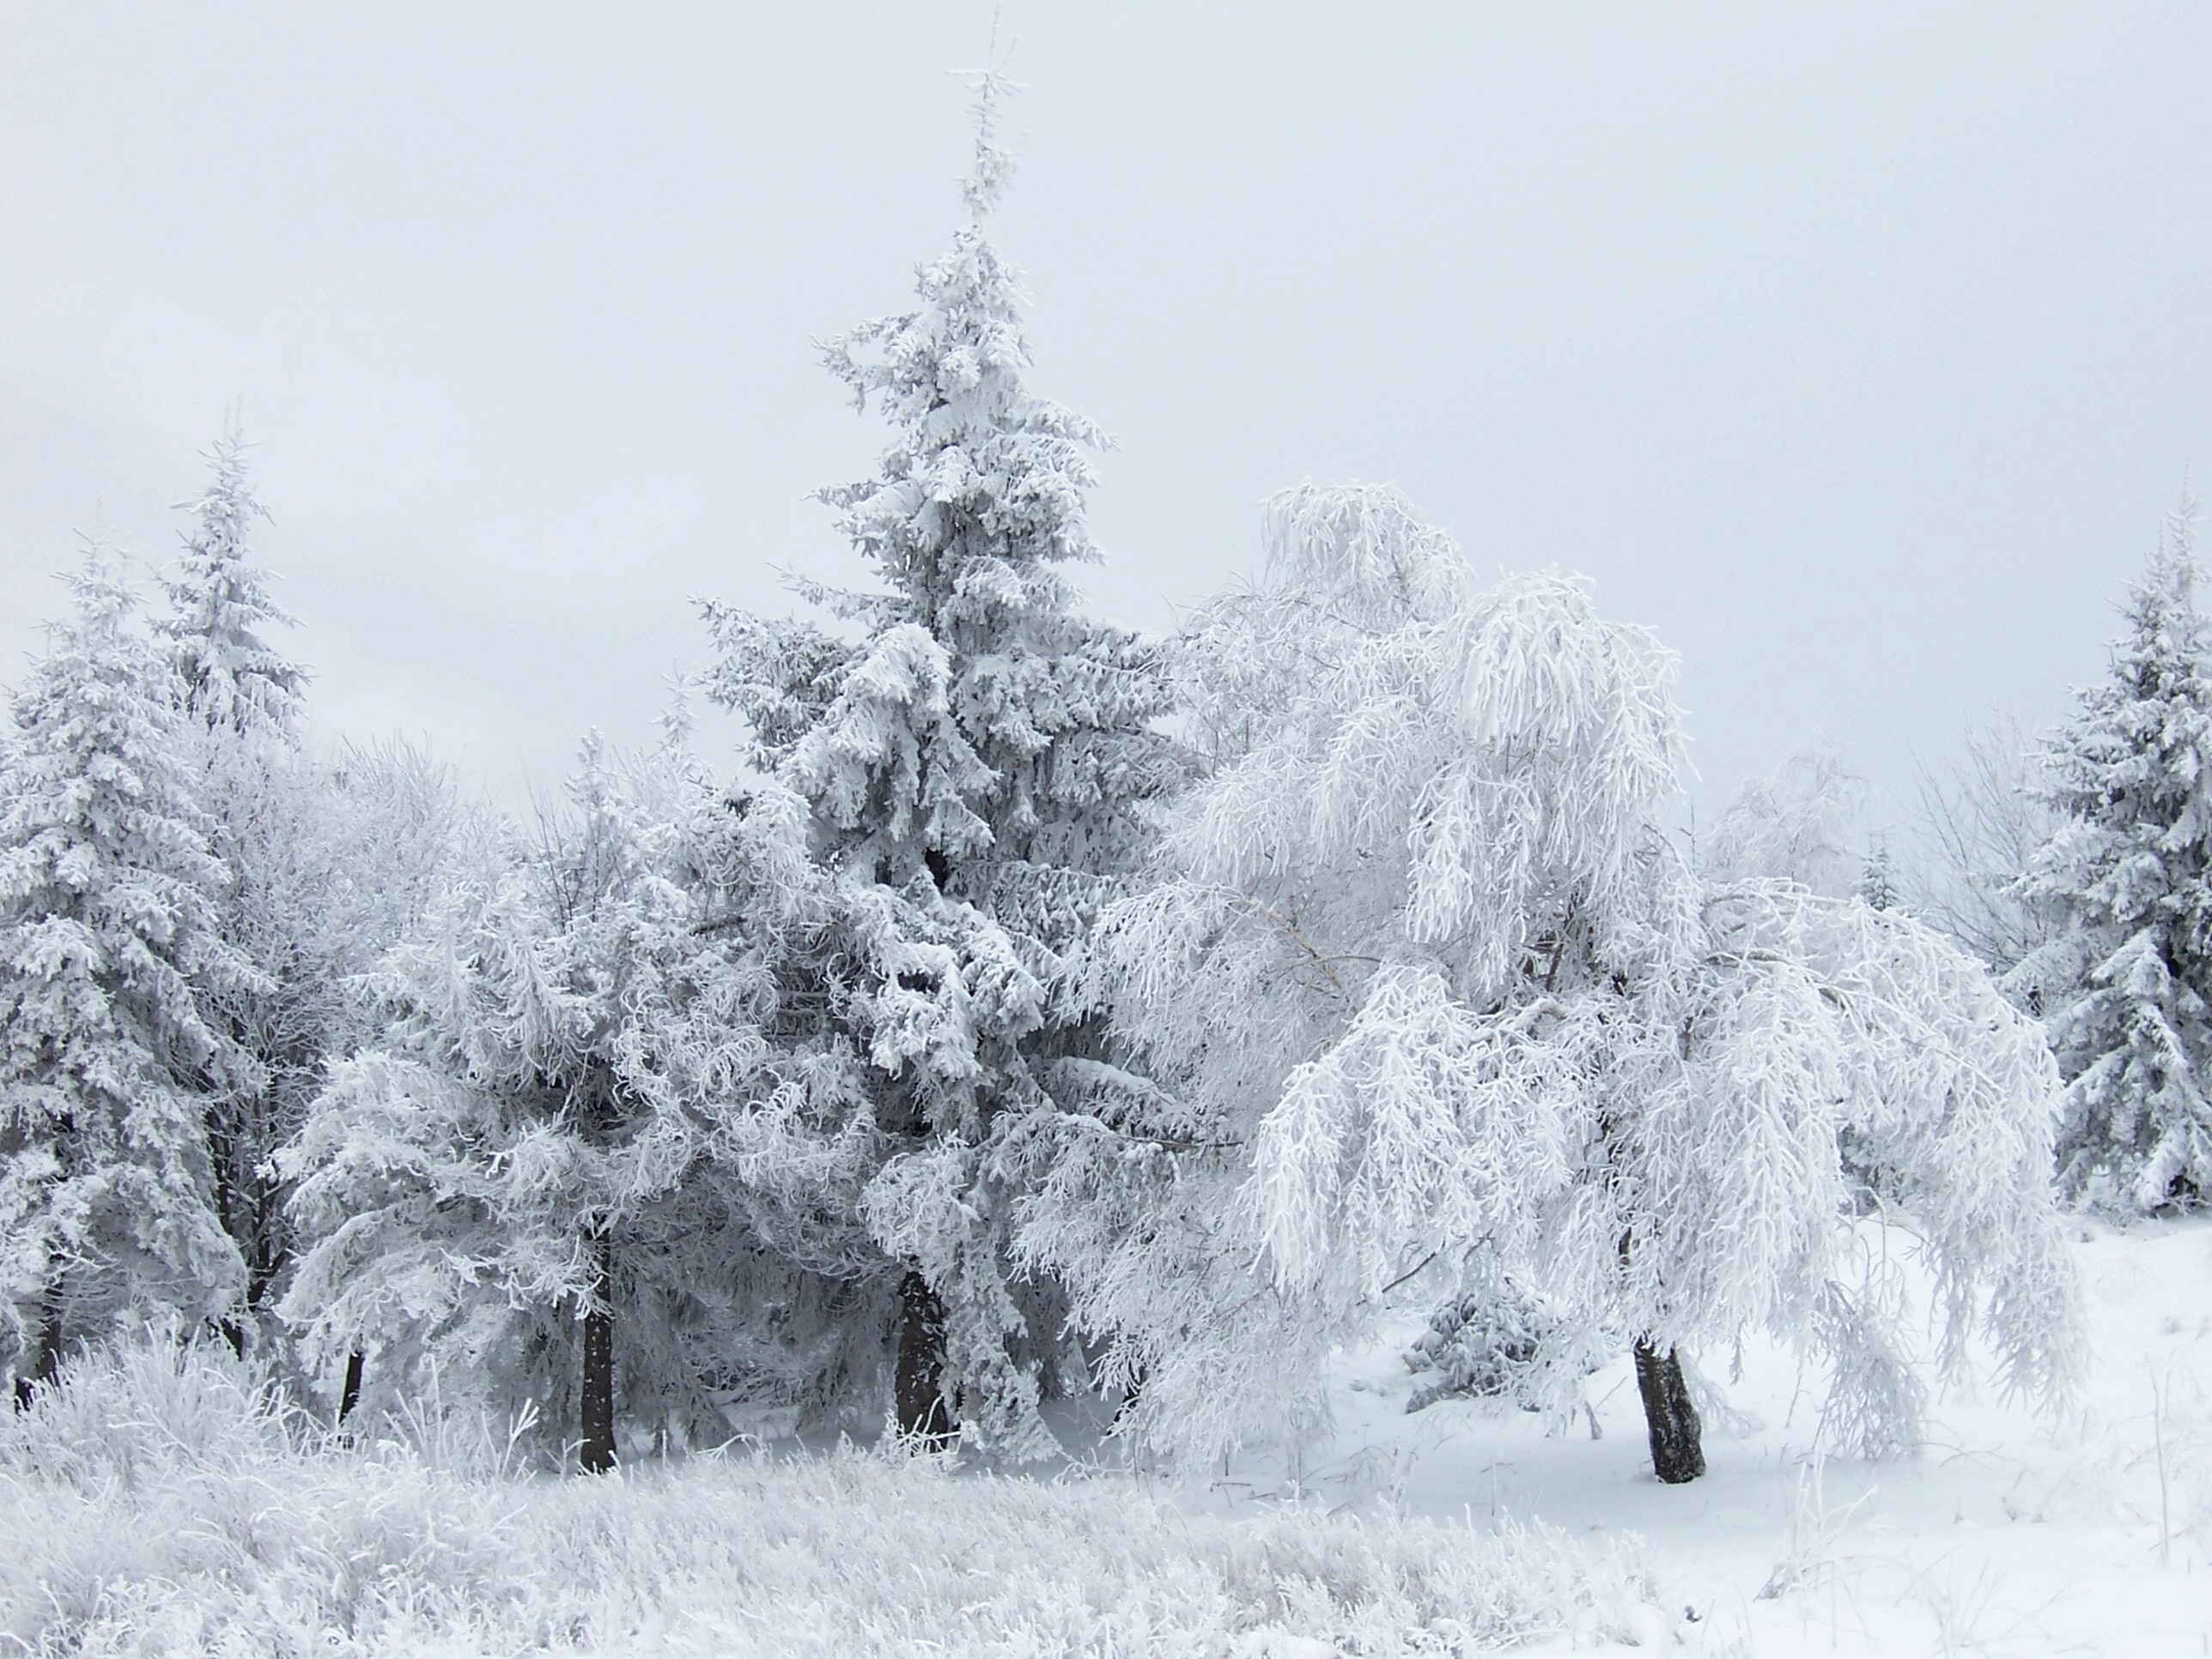
Snow Day!

Slide 4
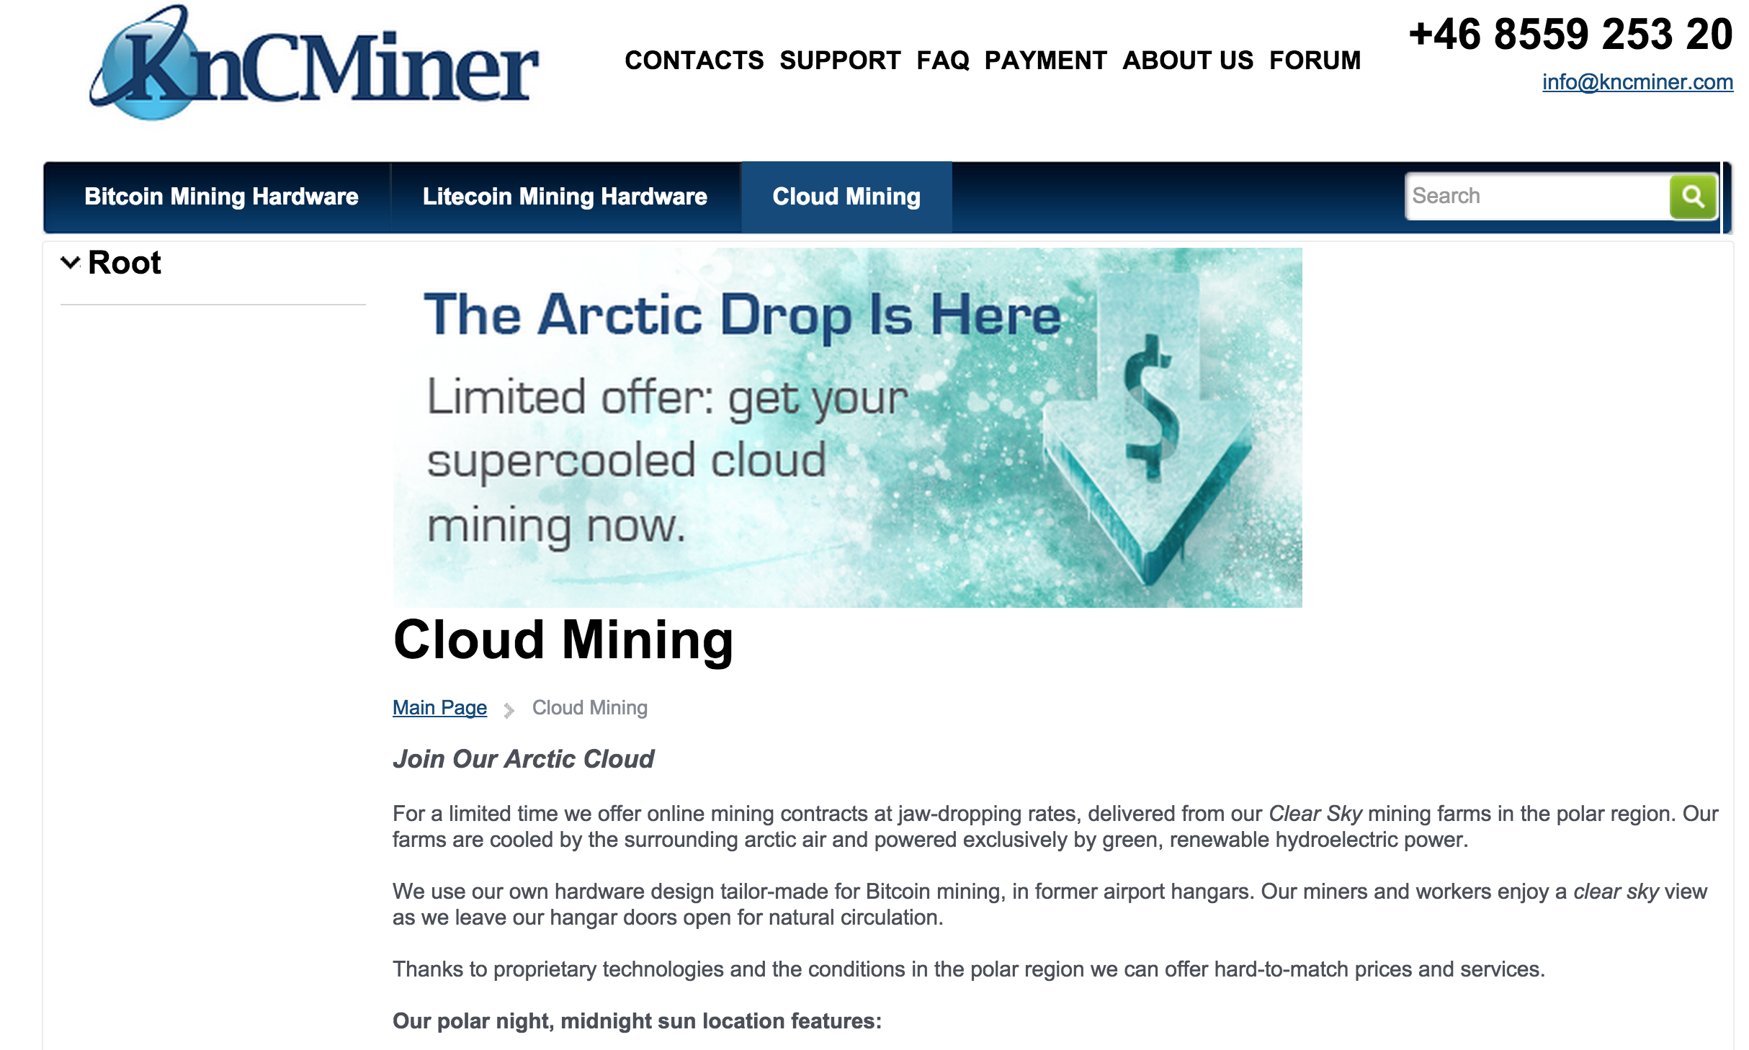

Slide 5

Is this gambling or a “good/bad” investment?

Slide 6
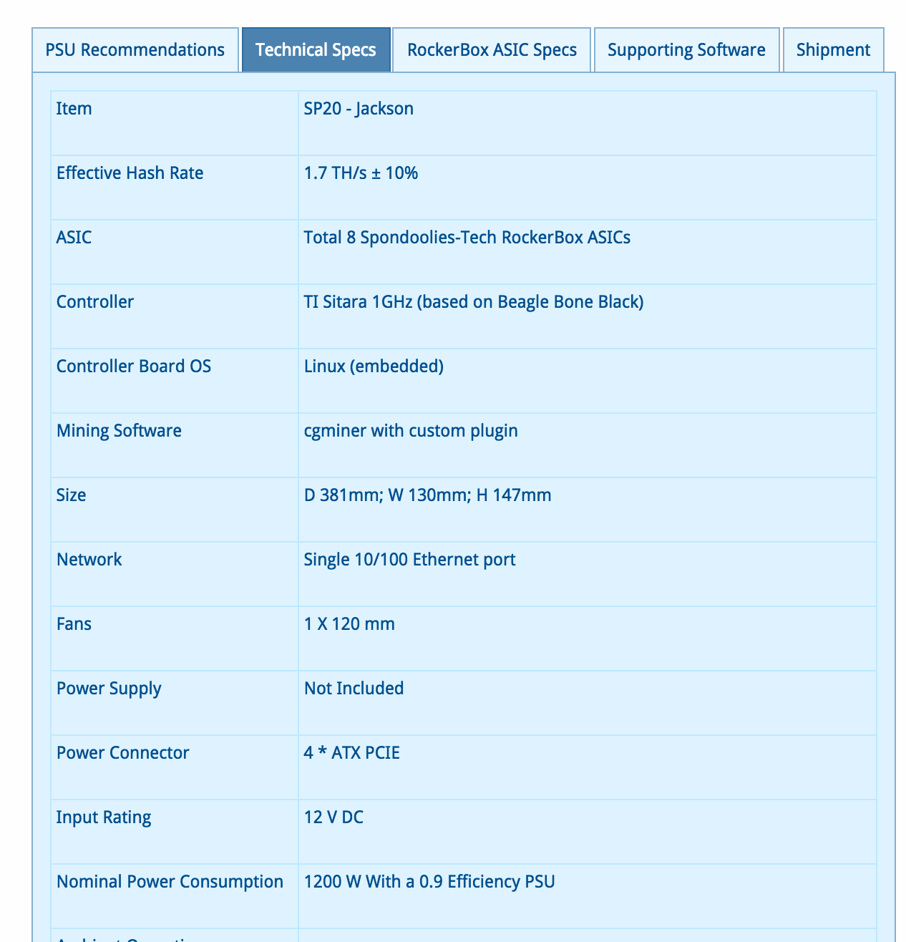

Slide 7
Expected Revenues (?)
Model
Cost: US$ 479
1.7 TH/s
BTC: US$ 240
Difficulty: (today)
>>> expected_hashes # at current difficulty
1.9093455768686638e+20
>>> expected_hashes / (1.7 * 10**12)
112314445.6981567 # expected seconds to find block
>>> _ / (60 * 60 * 24)
1299.935714099036 # days to find block
>>> block_value = 240 * 25
>>> earnings_per_year = block_value * (365.25 / 1300)
>>> earnings_per_year
1685.769230769231

Slide 8
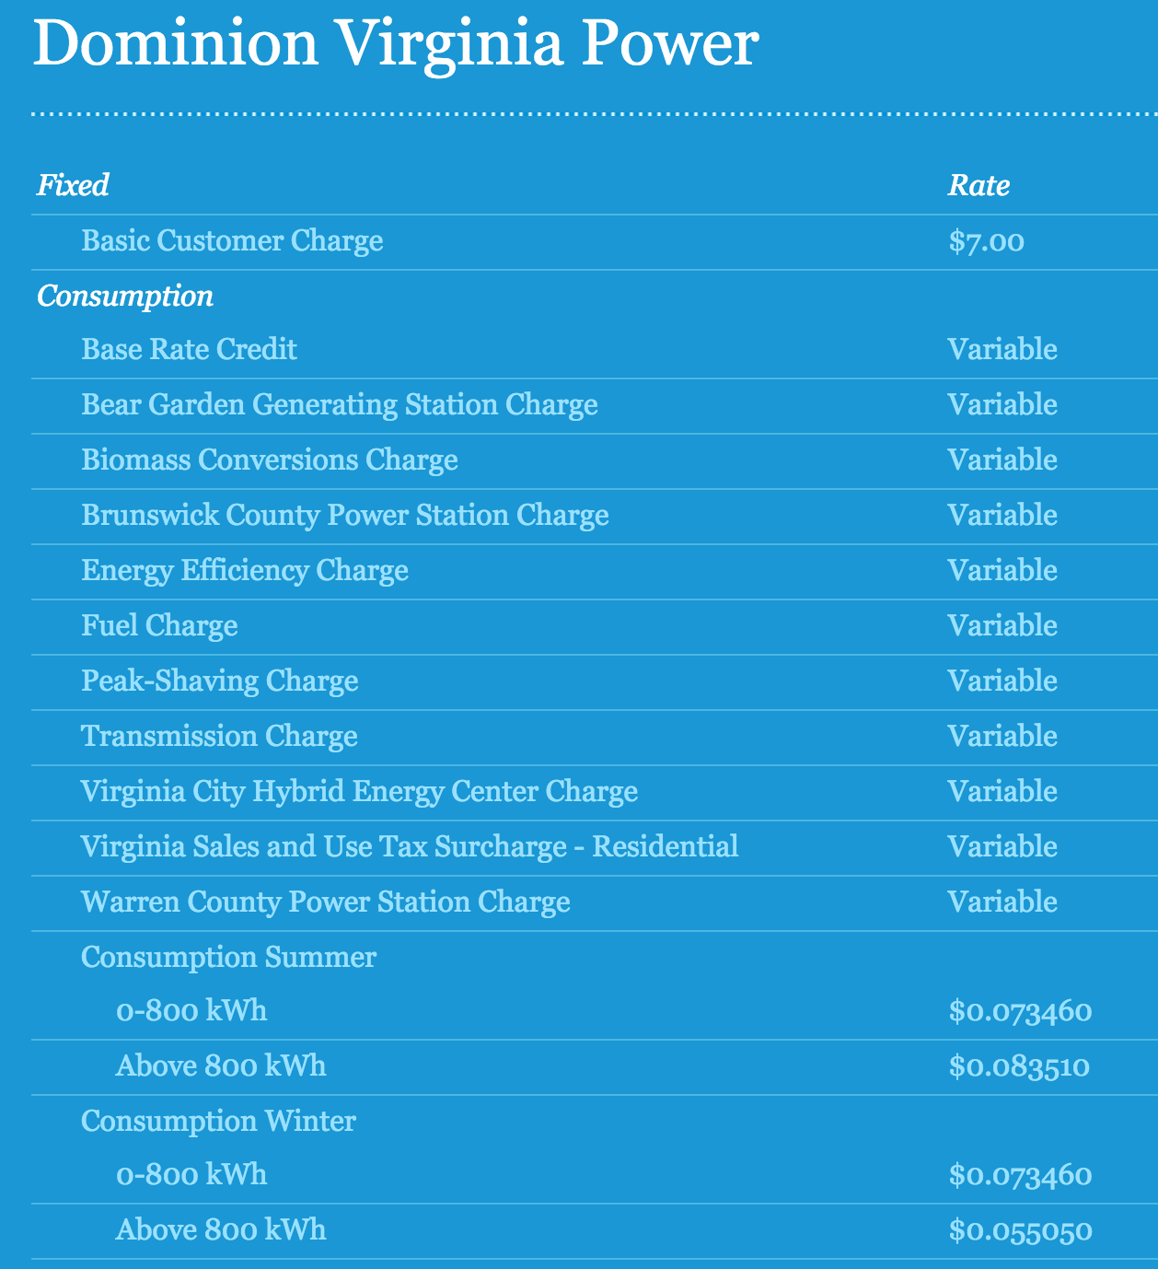
Operating Cost

Slide 9
Operating Profit
>>> kWh = 0.07
>>> hours_per_year = 24 * 365.25
>>> electricity_cost = (1.2 * kWh) * hours_per_year
>>> electricity_cost
736.344 # US $ per year
>>> profit_per_year = earnings_per_year - electricity_cost
949.4252307692309

Slide 10
Easy Money?

Slide 11
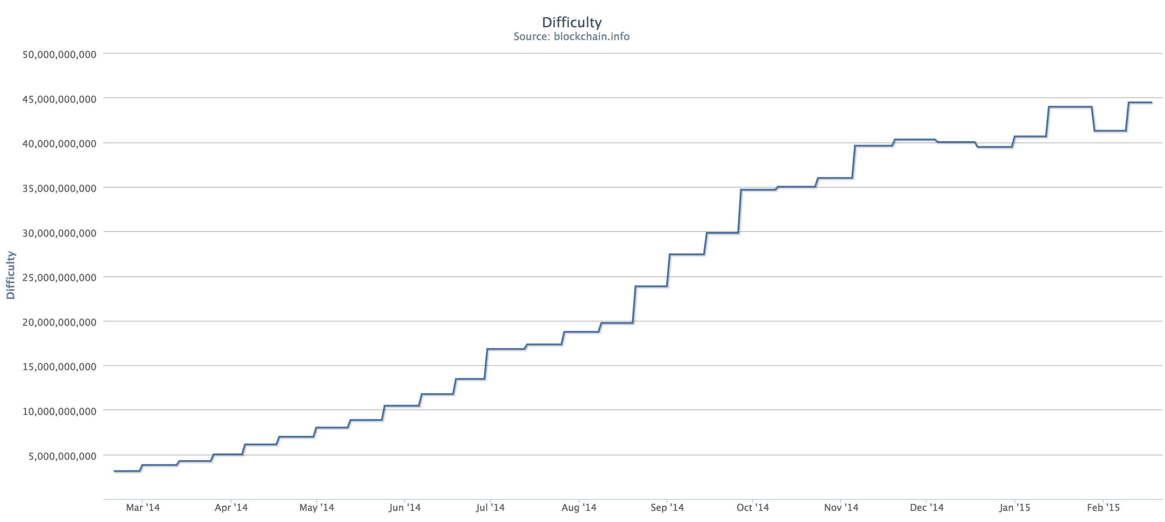
March 2014

Slide 12
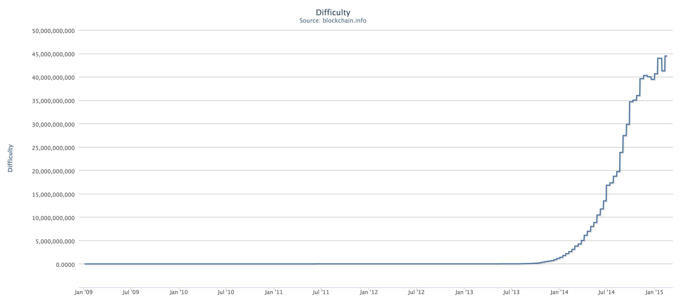

Slide 13
# this is a very low assumption - over past year, average rate was 0.35
rate_of_difficulty = 0.05
def guess_difficulty(month):
return difficulty * ((1 + rate_of_difficulty) ** month)
def expected_revenue(month):
success_probability = find_target(guess_difficulty(month)) / 2**256
return block_value * hashes_in_month * success_probability
def cumulative_income(months):
income = 0.0
month = 0
while month < months:
income += expected_income(month)
month += 1
return income

Slide 14
>> cumulative_income(1)
79.12571644571238
>>> cumulative_income(12)
571.0928818228372
>>> cumulative_income(24)
562.7786595271843
>>> cumulative_income(17)
619.9072133191279

Slide 15
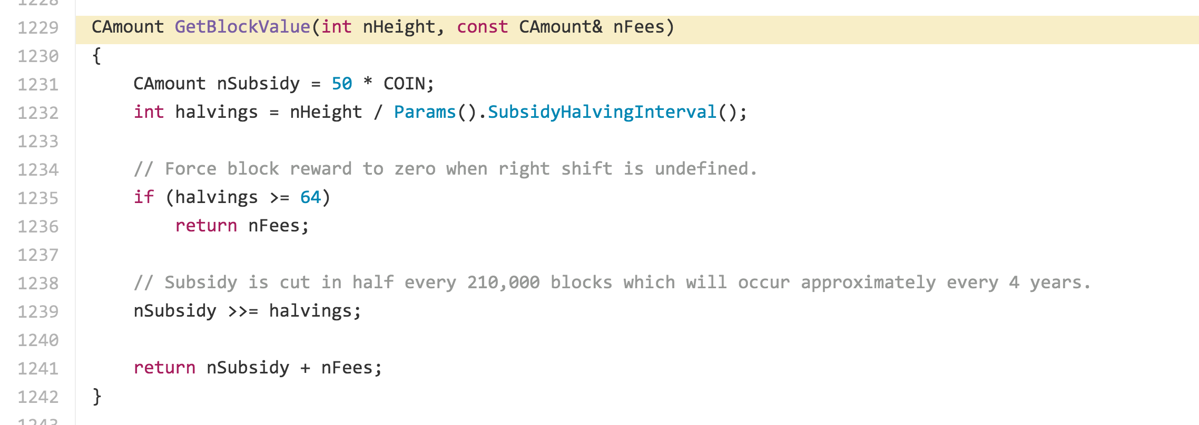
Block Value

Slide 16
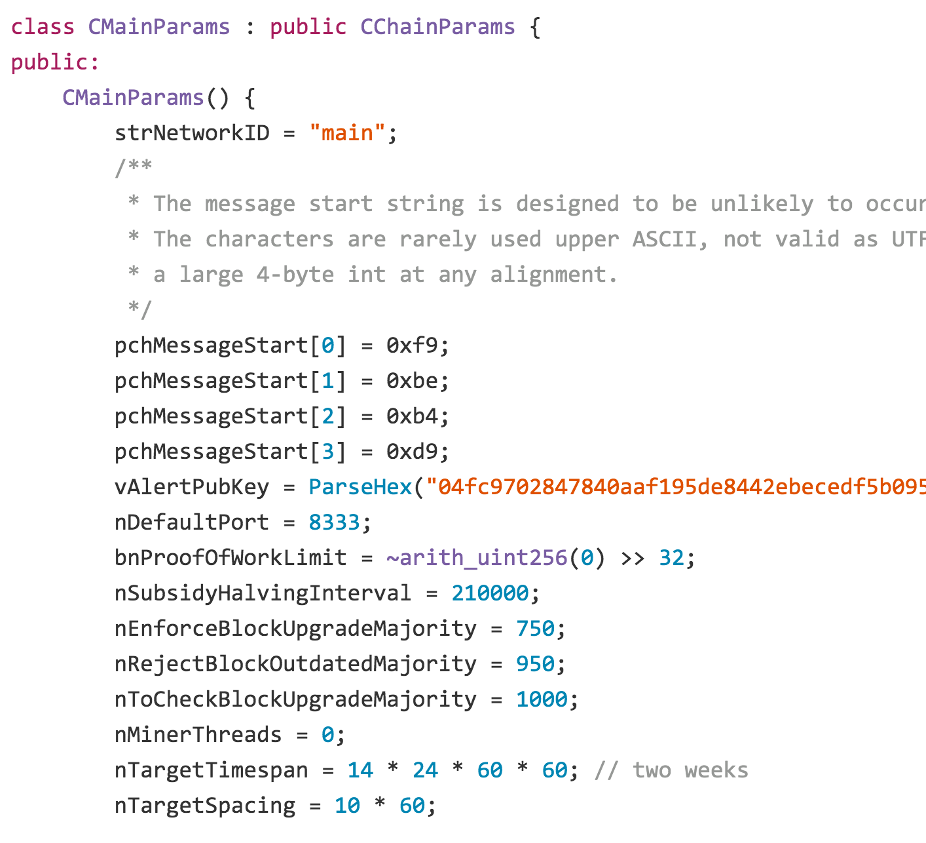

Slide 17
What happened around block 210000?
https://blockchain.info/block/00000000000000f3819164645360294b5dee7f2e846001ac9f41a70b7a9a3de1

Slide 18
Date | Difficulty | Block # | Days (delta) | Increase % Per Difficulty Adj | Daily increase % | Tl. Network Strength (Mhash/s) | Difficulty Increase
2012-11-12 | 3,368,767 | 207648 | 13.74 | 1.95% | 0.14% | 24,114,574 | 64,411
2012-11-26 | 3,438,909 | 209664 | 13.72 | 2.08% | 0.15% | 24,616,669 | 70,142
2012-12-10 | 3,370,182 | 211680 | 14.29 | -2.00% | -0.14% | 24,124,701 | -68,727
2012-12-26 | 2,979,637 | 213696 | 15.83 | -11.59% | -0.77% | 21,329,070 | -390,545
2013-01-08 | 3,249,550 | 215712 | 12.86 | 9.06% | 0.68% | 23,261,182 | 269,913
2013-01-23 | 2,968,775 | 217728 | 15.33 | -8.64% | -0.59% | 21,251,322 | -280,774
2013-02-05 | 3,275,465 | 219744 | 12.69 | 10.33% | 0.78% | 23,446,689 | 306,689

Slide 19
Expected Outcome
Given the expected useful lifetime of 17 months for this miner, what is the most likely result?

Slide 20
Expected Outcome
def expected_blocks(month):
success_probability = find_target(guess_difficulty(month)) / 2**256
return hashes_in_month * success_probability
def cumulative_expected_blocks(months):
blocks = 0
for month in range(months):
blocks += expected_blocks(month)
return blocks
Given the expected useful lifetime of 17 months for this miner, what is the most likely result?
cumulative_expected_blocks(17)
0.27717686888652143

Slide 21
Probability Refresher
What is the probability that tossing a fair coin k times produces 0 tails?

Slide 22
Probability of Finding No Blocks
With target T, what is the probability no block is found with K hashes?

Slide 23
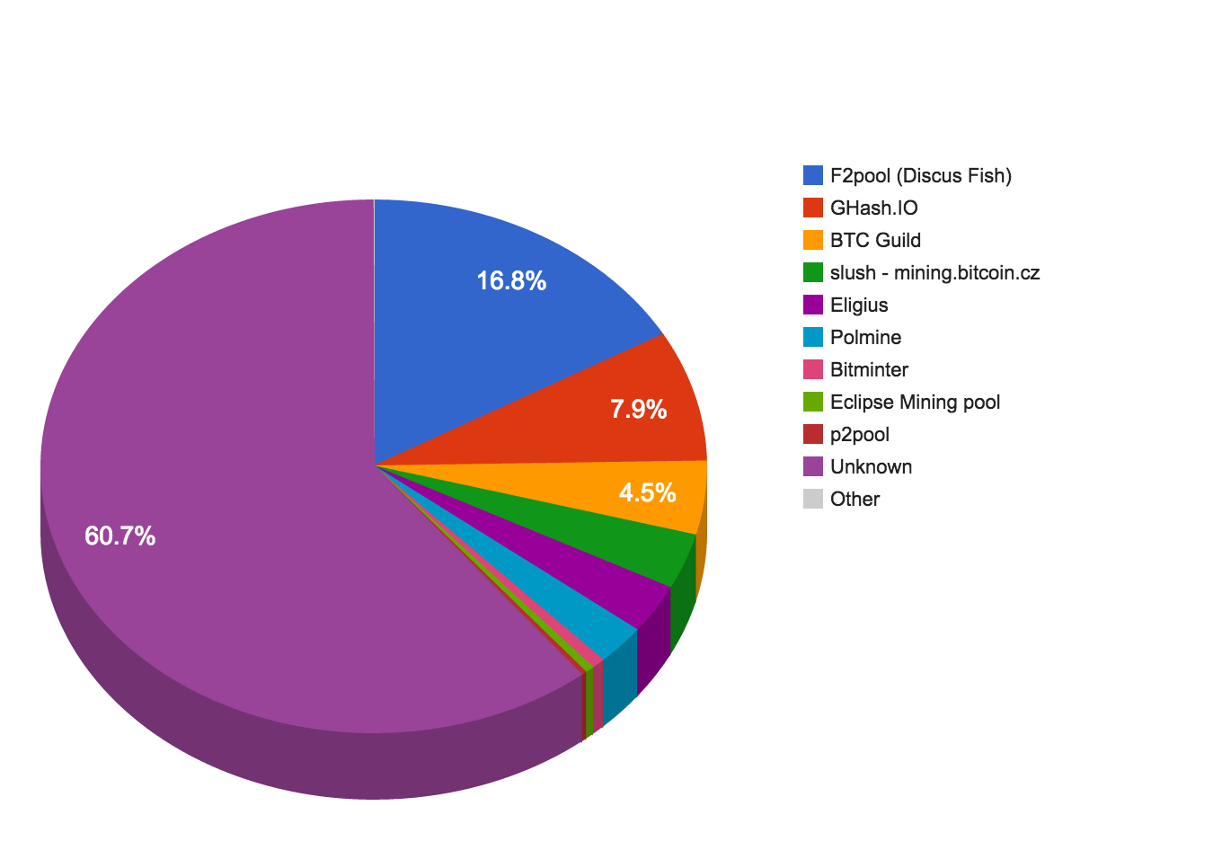

Slide 24
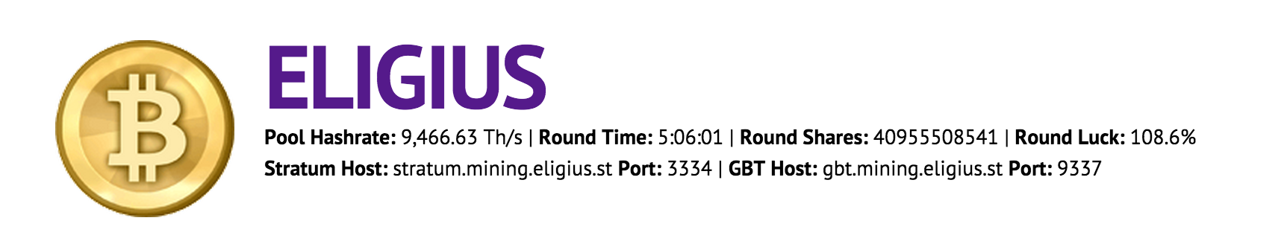
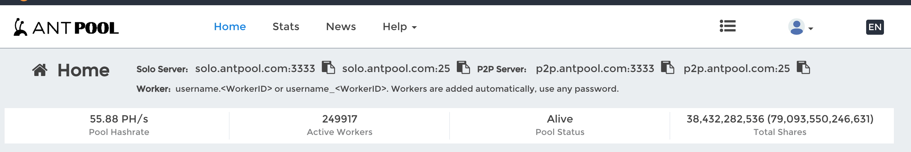
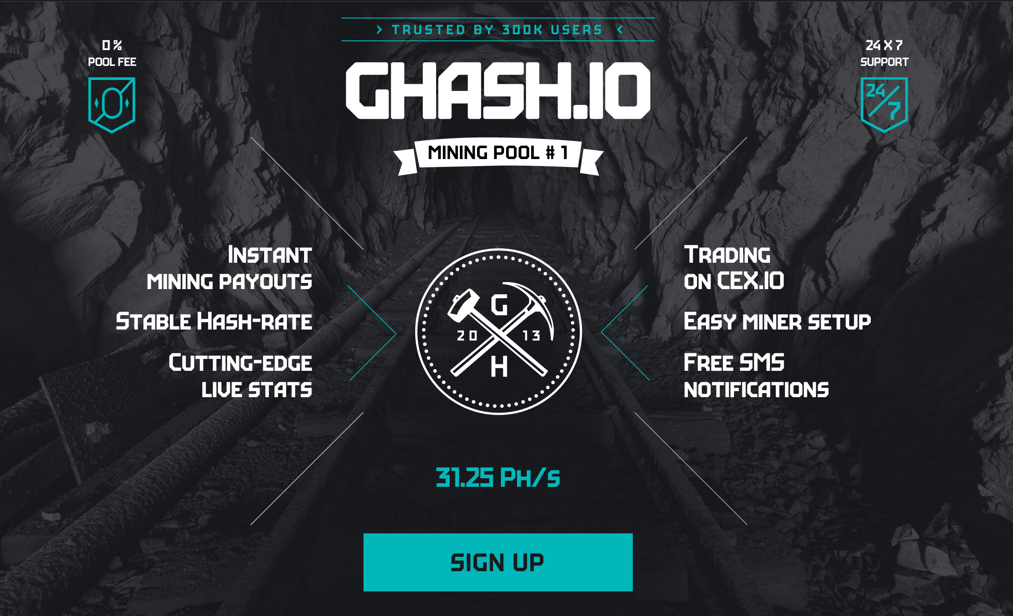
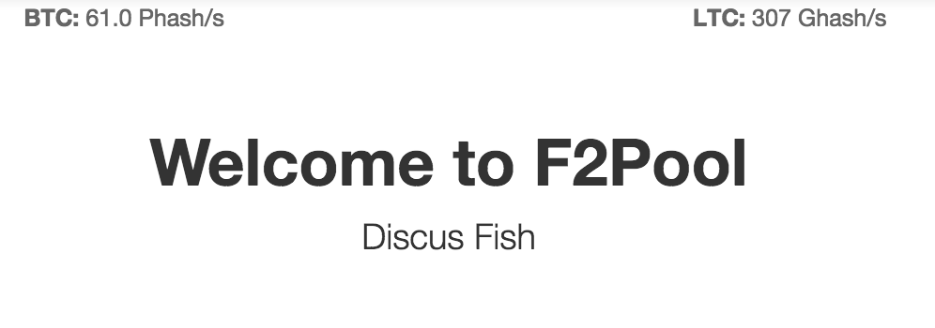
Mining Pools

Slide 25
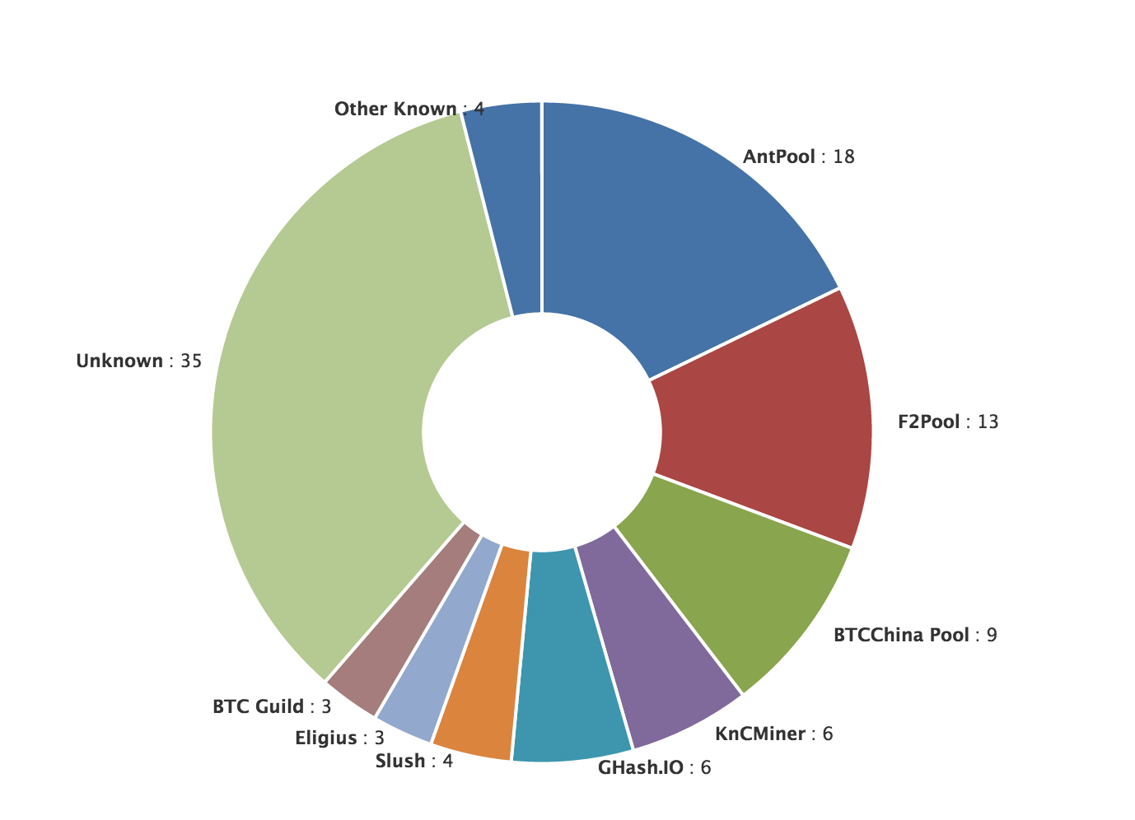
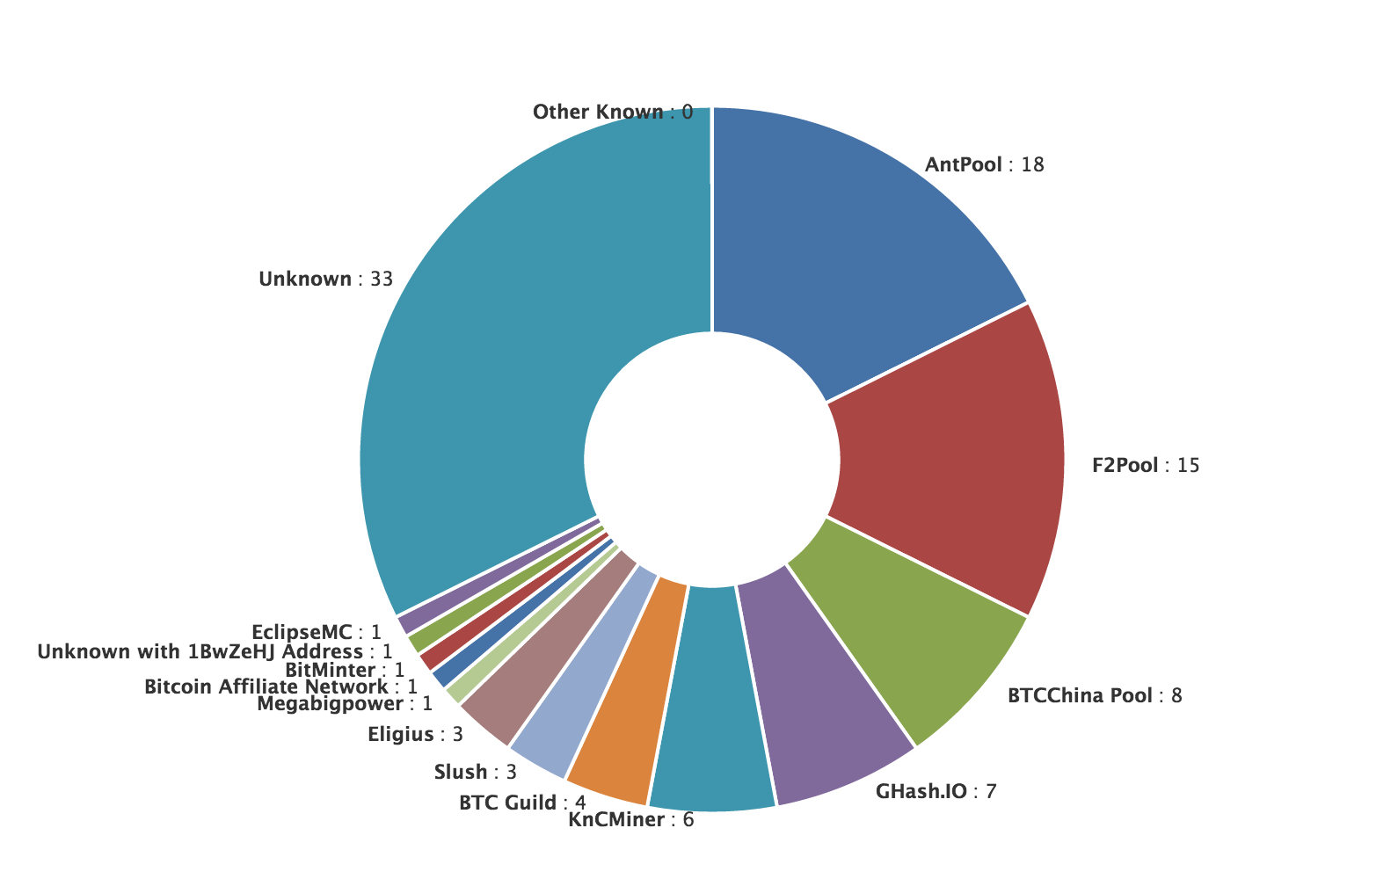
Mining Power
https://blockchain.info/pools?timespan=24hrs
Last 4 Days
Last 24 Hours

Slide 26
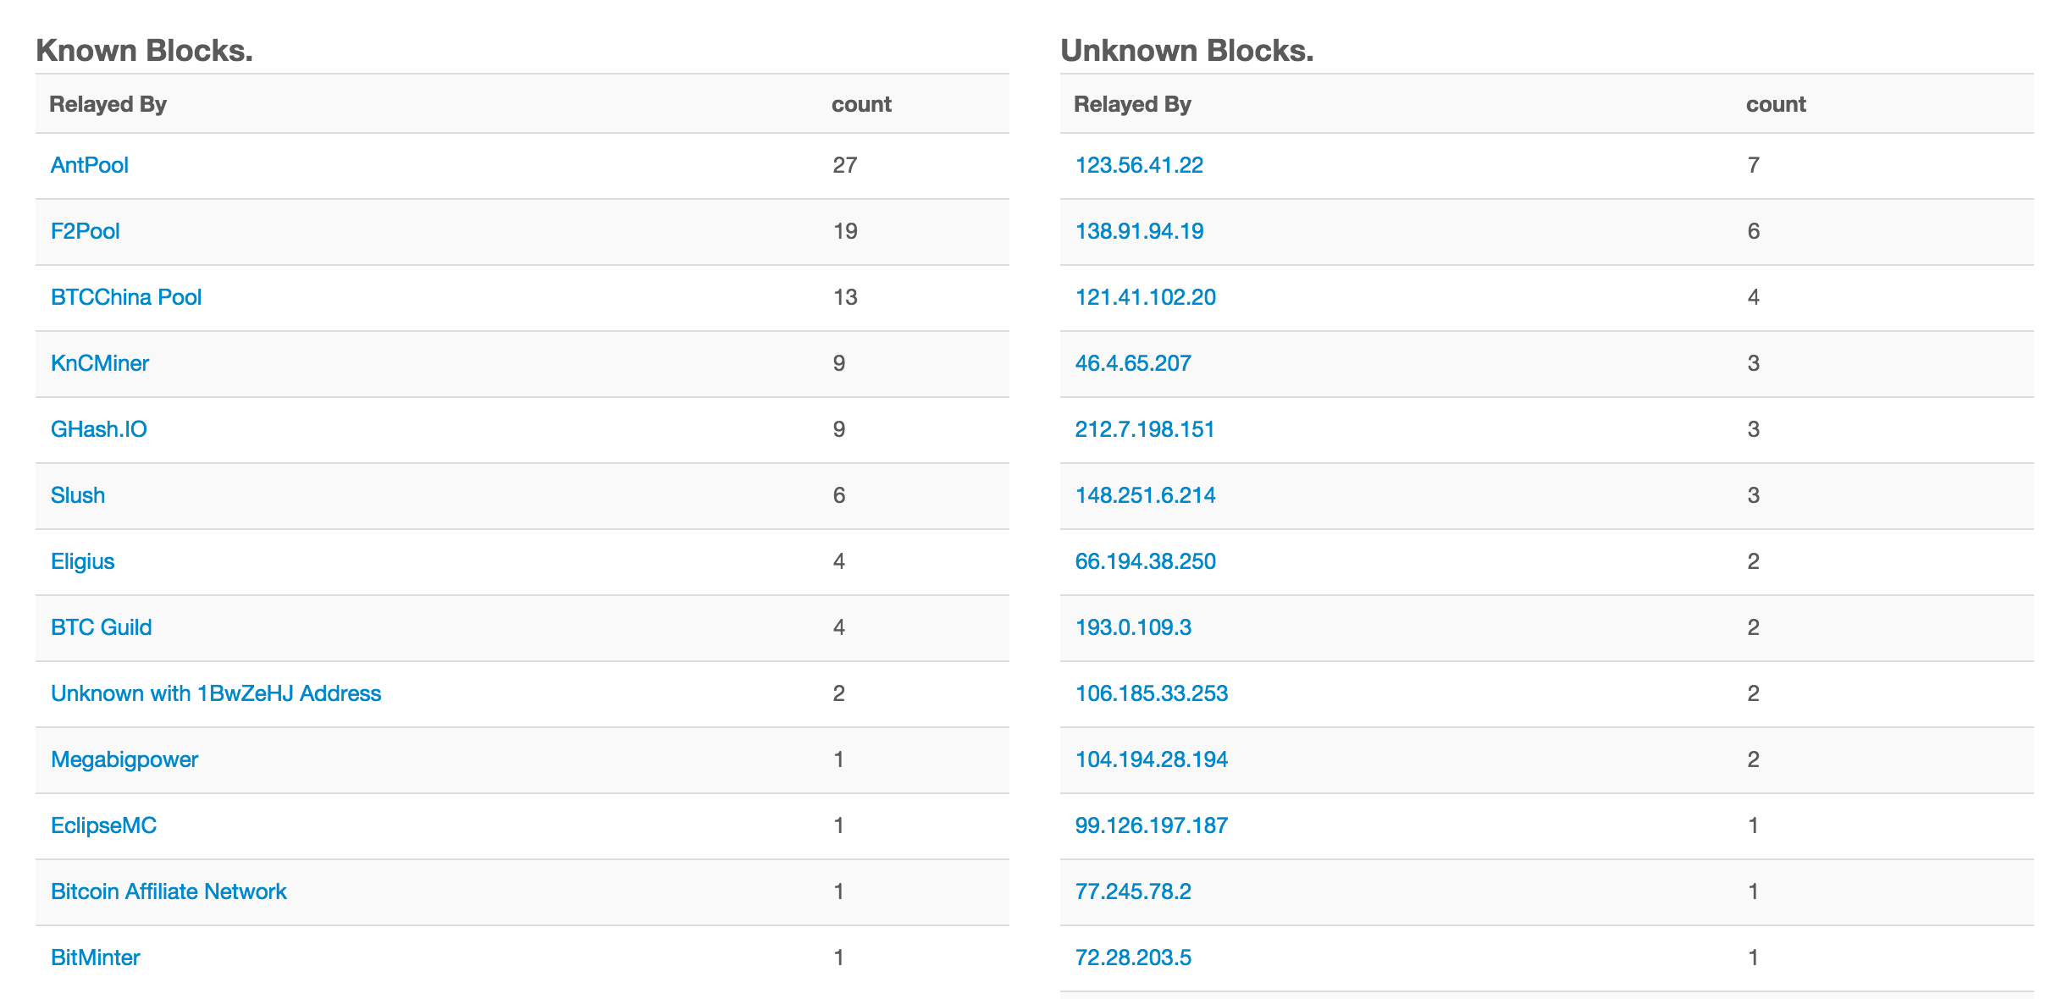
Last 24 hours

Slide 27
Mining Pools

Slide 28
Charge
“GHash.IO does not have any intentions to execute a 51% attack… it could risk our investments in physical hardware and we see no benefit from having 51% stake in mining.”
Don’t attack PointCoin yet!
Project 2 Part 1: Due Sunday
Quiz next Wednesday
If you don’t yet understand fundamentally how bitcoin works, definitely come to my office hours before then (Thursday 4-5pm, Monday 3:15-5pm)

